Slide 1


BANK RISK CONTROLLER SYSTEM
LOAN DEFAULT PREDICTION USING MACHINE LEARNING
&
BANKING KNOWLEDGE ASSISTANT USING RAG (LLM)

Slide 2
Larana, Inc.
PROBLEM STATEMENT
PROJECT OBJECTIVES
Banks face high financial risk due to loan defaults
Manual risk evaluation is:
Time-consuming
Error-prone
Not scalable
Customers also require:
Clear answers to banking rules
Instant support without human dependency
👉 Need for an intelligent system to:
Predict loan default risk
Provide banking policy assistance via chatbot
Build a Loan Default Prediction model
Identify High Risk vs Low Risk customers
Use historical loan data for predictions
Create an interactive Streamlit application
Develop a Banking Chatbot using:
PDF policy documents
Retrieval Augmented Generation (RAG)

Slide 3

DATASET OVERVIEW
EDA
Larana, Inc.
Dataset Source: Loan Data
Total Records: [14,13,700]
Total Features: [158]
File size : 1 GB
Memory usage : 1.7+GB
Target Variable:
TARGET → 1 (Default), 0 (No Default)
Age vs Default Risk Analysis
Income vs Credit Amount comparison
Default rate based on:
Gender
Employment years
EXT_SOURCE scores impact on default
Identified strong predictors for loan risk
DATA PREPROCESSING STEPS
Removed missing and invalid values null values 50%
Converted negative day values to:
AGE in years
EMPLOYMENT duration in years
Feature Engineering & Reduction :
Created BIRTH_YEAR
Binned CNT_CHILDREN
Encoded categorical variables Label Encoder
Handled class imbalance
Final cleaned dataset saved for modeling

Slide 4

Larana, Inc.
MODEL BUILDING
Machine Learning Models Tried:
Logistic Regression
Random Forest(Final Model)
Gradient Boosting
LightGBM
XGBoosting tunning
Extra Tree
Decision Tree
Final Model:
✅ Random Forest
Why Random Forest?
Handles large datasets efficiently
Better performance on imbalanced data
Faster training time

Slide 5


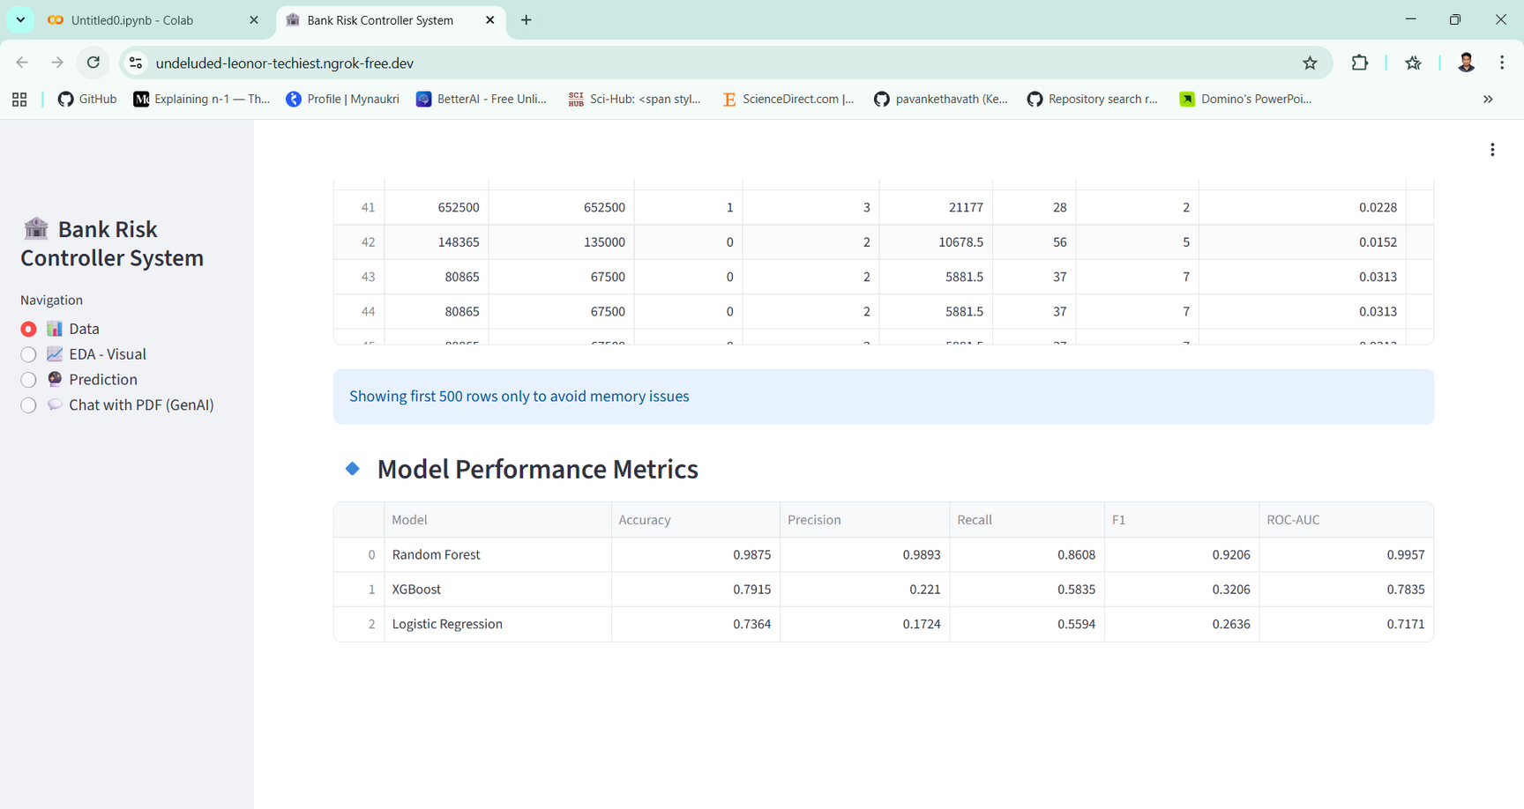


Larana, Inc.
MODEL EVALUATION

Slide 6

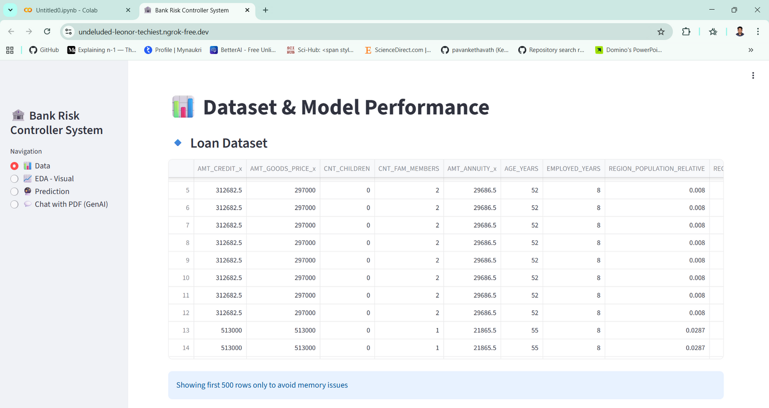
STREAMLIT APPLICATION
Larana, Inc.

Slide 7
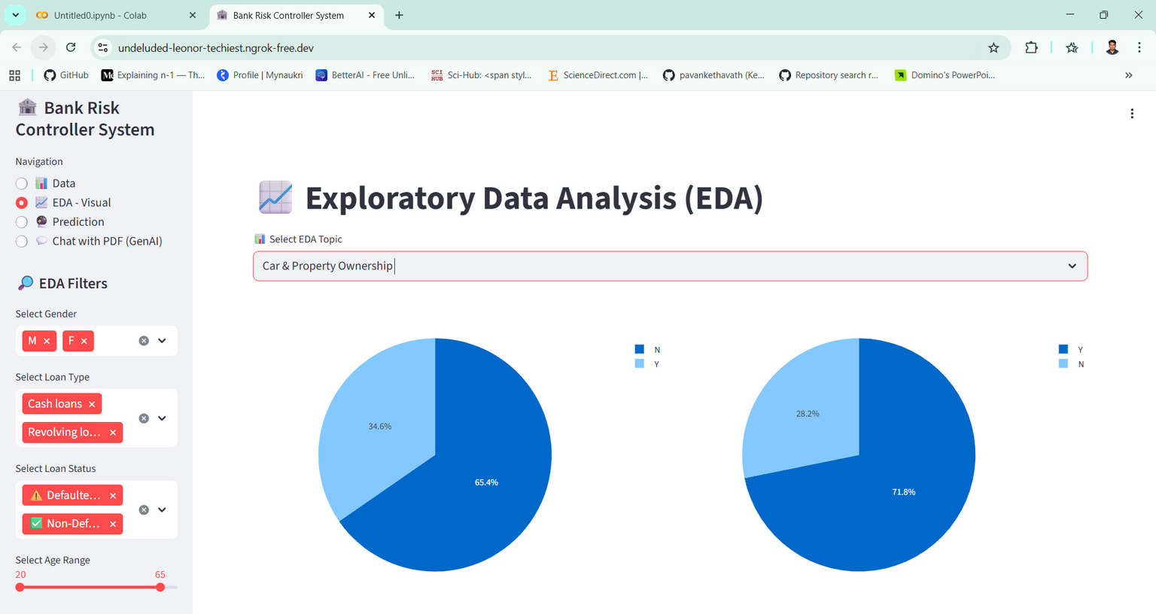
Larana, Inc.
EDA

Slide 8
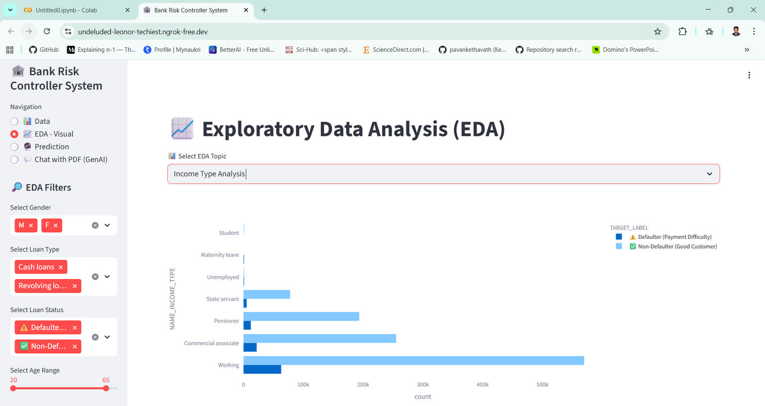
Larana, Inc.
EDA

Slide 9



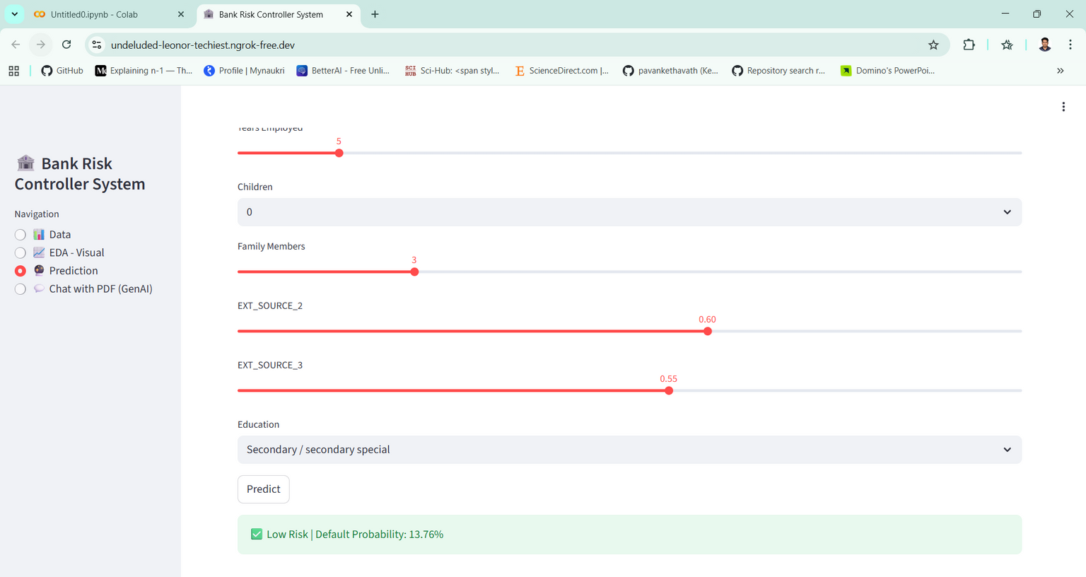
PREDICTION SYSTEM
Larana, Inc.
Prediction SystemUser Inputs:
Age
Gender
Income
Loan Amount
Employment Years
Children Count
EXT_SOURCE scores
Output:
LOW RISK or HIGH RISK
Default Probability (%)
✔ Feature name mismatch issue solved
✔ Prediction works in real-time

Slide 10

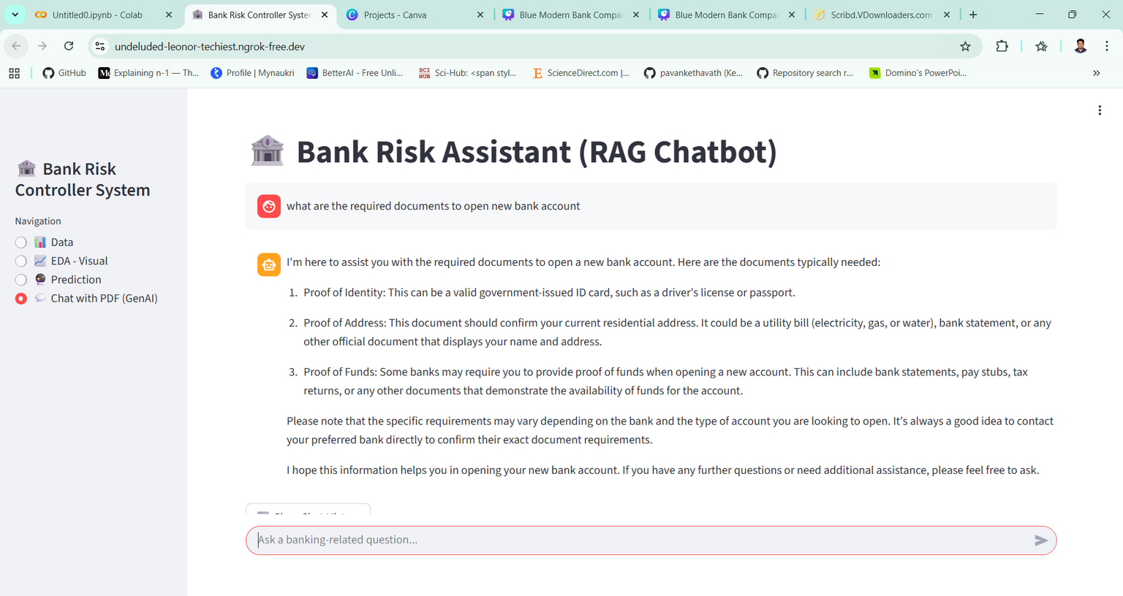


PDF Loading (Bank Policy Documents)
Text Chunking
Sentence Embeddings
Vector Database (ChromaDB)
Query Retrieval
Answer Generation using LLaMA
Models Used:
aminhaeri/risk-embed (Embeddings)
Mistral-7B Banking LLaMA
Larana, Inc.
Chatbot Architecture

Slide 11
SYSTEM ARCHITECTURE
CHALLENGES FACED
Larana, Inc.
User Interface → Streamlit
Prediction Engine → ML Model
Chatbot Engine → RAG + LLaMA
Data Storage → CSV, PDF, Pickle
Feature mismatch during prediction
High memory usage during training
LangChain version conflicts
Model loading time issues
RESULTS & IMPACT
FUTURE ENHANCEMENTS
Accurate loan risk prediction
Reduced manual decision making
Intelligent banking assistant
Scalable and reusable architecture
Practical real-world application
Add Explainable AI (SHAP)
Multilingual chatbot support
Real-time database connection
Cloud deployment (AWS / Azure)
Role-based access system

Slide 12

CONCLUSION
Successfully built an end-to-end ML system
Combined predictive analytics with LLMs
Demonstrated real-world banking use case
Strong integration of Data Science concepts

